Slide 1
Azure Data Overview
Himanshu Desai (Readify Principal Consultant)

Slide 2
Agenda
SQL Database
SQL Server VM
DocumentDB
Notes:
The Azure data Platform is HUGE and growing. This session will have to be brief about some of this content and make a few deep dives here and there.

Slide 3
SQL Database
Notes:
Now let’s focus on Microsoft Azure SQL Database the PaaS service!

Slide 4

Microsoft Relational Storage Options
A Continuous offering
Physical
Virtual
IaaS
PaaS
From private to public Cloud
Notes:
Slide Objectives:
Show Microsoft’ continuous Private to Public Cloud Offering, but this presentation will focus on Microsoft’s relational database PaaS offering.
Transition:
Microsoft provides a continuous solution from private cloud to the public cloud. No matter where you are on your technology roadmap we have a solution to fit your needs.
We are a trusted advisor and platform in the traditional enterprise and ISV space with new IaaS offerings that making it easier to bring this same level of trust and ease of use to the public cloud. However, Microsoft Azure SQL Database extends SQL Server capabilities to the cloud by offering SQL Server as a relational database service.
Speaking Points:
SQL Database provides SQL Server as a relational service.

Slide 5
Architecture
Starting with the basics

Slide 6
A Server is not a machine
SQL Server
Machine
(Physical/VM)
Azure
SQL Database Server
TDS Endpoint
Notes:
Slide Objectives:
Understand that while there are physical SQL Server boxes behind the scenes, when connecting to SQL Database, you are not connecting to a physical server, but to a TDS endpoint.
Transition:
The key to understanding SQL Database is understanding while SQL Database is SQL Server, we do not interact with them in the same physical manner.
Speaking Points:
In an on-premises environment, we typically have physical access to the actual SQL Server server.
In Microsoft Azure, we do not have physical access to the actual server.
Notes:
It is important that the attendee understands that it IS INDEED SQL Server at the platform layer. There are physical boxes running SQL Server 2012 Enterprise Edition. However, due to the nature of the Azure environment to provide the high-availability and scalability necessary, access to the physical boxes is currently not supported.

Slide 7
SQL Database The Basics
SQL Server database technology “as a Service”
Fully Managed
Enterprise-ready with automatic support for HA, DR, Backups, replication and more
Notes:
Slide Objectives:
Understand the overall concepts and benefits of SQL Database
Transition:
Let’s clear up any confusion and look at the basics of what SQL Database really is and some of its benefits.
Speaking Points:
The same great SQL Server database technology that you know, love, and use on-premises provided as a service
Enterprise-ready
Automatic support for High-Availability
Designed to scale on-demand to provide the same great elasticity
Notes:
High-availability – 3 copies of the database free for the cost of the one database. Always in sync. The cost to do this on-premises isn’t cheap. This is FREE in SQL Database.

Slide 8
SQL Database The Basics
Scale out with ElasticScale
Built-in regional database replicas for additional protection
Uptime SLA of 99.99%
Notes:
Slide Objectives:
Understand the overall concepts and benefits of SQL Database
Transition:
Let’s clear up any confusion and look at the basics of what SQL Database really is and some of its benefits.
Speaking Points:
The same great SQL Server database technology that you know, love, and use on-premises provided as a service
Enterprise-ready
Automatic support for High-Availability
Designed to scale on-demand to provide the same great elasticity
Notes:
High-availability – 3 copies of the database free for the cost of the one database. Always in sync. The cost to do this on-premises isn’t cheap. This is FREE in SQL Database.

Slide 9
How It Works – Architecture of the Service
Client Layer
PHP
SQL Server
Applications
and Tools
WCF Data Services
Applications communicate directly with SQL Database using TDS.
ODBC
ADO.NET
Tabular Data Stream (TDS)
Notes:
Client - The client layer resides closest to your application, and is used by your application to communicate directly with SQL Database. The client layer can reside on-premise in your datacenter or be hosted in Microsoft Azure. Because SQL Database provides the same tabular data stream (TDS) interface as SQL Server, you can use familiar tools and libraries to build client applications for data that is in the cloud.

Slide 10
How It Works – Architecture of the Service
Client Layer
PHP
SQL Server
Applications
and Tools
WCF Data Services
ODBC
ADO.NET
Tabular Data Stream (TDS)
TDS+SSL
Gateway between Client layer and Platform layer.
Services Layer
Provisioning
Billing and Metering
Connection Routing
Notes:
Services - The services layer functions as a gateway between the client layer and the platform layer, where the data resides. The services layer provides three functions: provisioning, billing and metering, and connection routing.
The services layer provisions the databases that you specify with your Microsoft Azure platform account. The billing and metering aspect of the services layer enables multi-tenant support by providing monitoring and billing for database usage based on individual Microsoft Azure platform accounts. SQL Database is built on a scalable platform involving numerous physical servers; this layer handles all the connections routing between your application and the physical servers where your data resides.

Slide 11
How It Works – Architecture of the Service
Client Layer
PHP
SQL Server
Applications
and Tools
WCF Data Services
ODBC
ADO.NET
Tabular Data Stream (TDS)
TDS+SSL
Services Layer
Provisioning
Billing and Metering
Connection Routing
Includes physical servicers and services that support the Services layer.
Platform Layer
SQL Server
SQL Database Fabric
Management Services
Notes:
Platform - The platform layer includes the physical servers and services that support the services layer. The platform layer consists of many instances of SQL Server, each of which is managed by the SQL Database fabric.
The SQL Database fabric is a distributed computing system composed of tightly integrated networks, servers, and storage. It enables automatic failover, load balancing, and automatic replication between physical servers.
Management services monitor the health of individual servers and enable automated installation of service upgrades and software patches.

Slide 12
How It Works – Architecture of the Service
Client Layer
PHP
SQL Server
Applications
and Tools
WCF Data Services
ODBC
ADO.NET
Tabular Data Stream (TDS)
TDS+SSL
Services Layer
Provisioning
Billing and Metering
Connection Routing
Platform Layer
SQL Server
SQL Database Fabric
Administration of the physical HW and OS.
Management Services
Infrastructure Layer
Notes:
Infrastructure - The infrastructure layer represents the IT administration of the physical hardware and operating systems that support the services layer.

Slide 13
How It Works – Architecture of the Service
Client Layer
PHP
SQL Server
Applications
and Tools
WCF Data Services
ODBC
ADO.NET
Tabular Data Stream (TDS)
TDS+SSL
Services Layer
Provisioning
Billing and Metering
Microsoft Azure SQL Database
PaaS
Connection Routing
Platform Layer
SQL Server
SQL Database Fabric
Management Services
Infrastructure Layer
Notes:
Slide Objectives:
To understand the actual architecture that provides the enterprise-ready SQL Database service.
Transition:
Developers have spent years working with their technology of choice, and Microsoft wanted to ensure that the technologies and tools you use today will continue to work with SQL Database without learning a whole new set of technologies.
Speaking Points:
Familiar technology and tools
Similar architecture as that of on-premises
Additional layer providing server and database partitioning, client connection routing, and billing.
Same great SQL Server technology on the backend.
Additional services (SQL Database Fabric) to ensure SLAs are met and to ensure optimum performance.

Slide 14
SQL Database Server
The Service head contains databases
Connect via automatically generated FQDN: {name}.database.windows.net
Initially contains only a master database
Notes:
Slide Objectives:
Show the different methods of provisioning a SQL Database server along with how easy it is. Plus, help the attendees understand what a SQL Database “server” really is.
Transition:
Provisioning an on-premises SQL Server box can be time consuming, costly, and at times, a challenge. With SQL Database, provisioning a “server” is painless, quick, and provisioned in a matter of seconds.
Speaking Points:
Provision servers interactively using the Management Portal
Automate server provisioning using the Microsoft Azure Management API or PowerShell.
Notes:
While the “server” is technically a TDS endpoint, much of the SQL Server process is similar. Administration login credentials are still needed for security, and more importantly defining service access is essential, and required, for maintaining the integrity of your server through firewall rules.

Slide 15
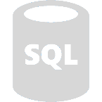





Server Connectivity
IP Based Firewall Rules
SQL Database Server
Allow Azure Services
Full Access
Selective Access
Azure Services
Notes:
Slide Objectives:
Explain SQL Server Database Connectivity.
Speaking Points:
Explain how data is protected using server-level firewall and database-level firewall rules.
Explain the difference when services connecting to SQL Databases from the internet versus services connecting from the Azure Datacenters.

Slide 16
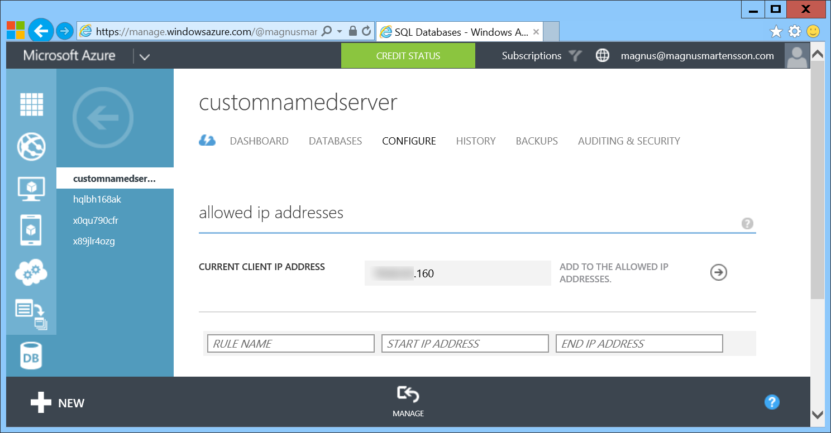
Provision Servers Interactively
In the Management Portal add firewall rules
Notes:
Slide Objectives:
Show how to configure IP-Filtering in the firewall for the SQL Database Server.

Slide 17
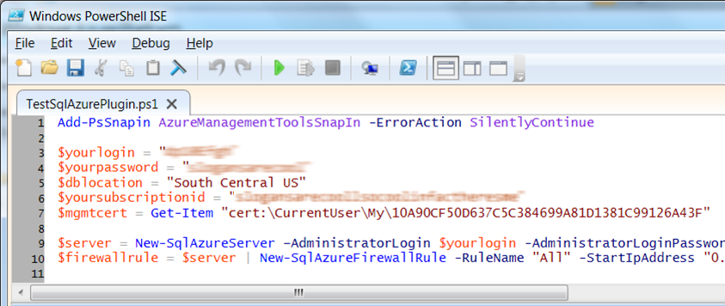
Automate Server Provisioning
Microsoft Azure Platform PowerShell cmdlets
http://bit.ly/azurepowershell
Notes:
Slide Objectives:
Show the different methods of provisioning a SQL Database server along with how easy it is. Plus, help the attendees understand what a SQL Database “server” really is.
Transition:
Provisioning an on-premises SQL Server box can be time consuming, costly, and at times, a challenge. With SQL Database, provisioning a “server” is painless, quick, and provisioned in a matter of seconds.
Speaking Points:
Provision servers interactively using the Management Portal
Automate server provisioning using the Microsoft Azure Management API or PowerShell.
Notes:
While the “server” is technically a TDS endpoint, much of the SQL Server process is similar. Administration login credentials are still needed for security, and more importantly defining service access is essential, and required, for maintaining the integrity of your server through firewall rules.

Slide 18
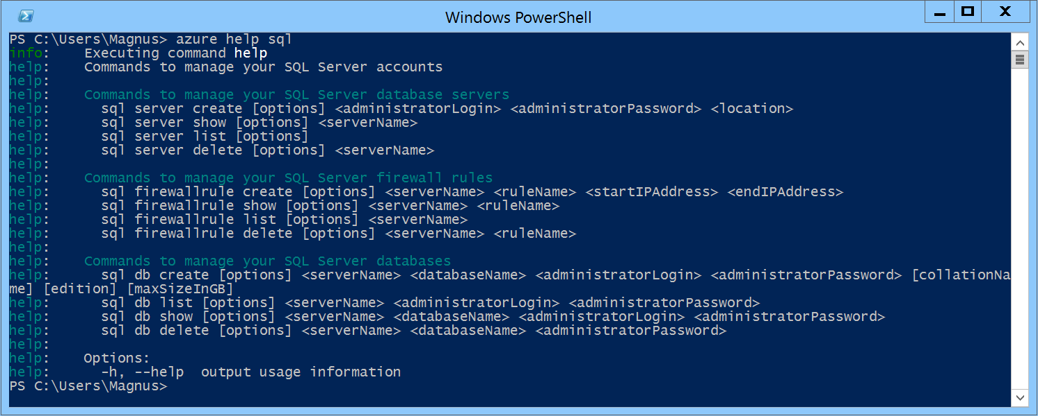
Automate Server Provisioning
Azure Cross-Platform Command-Line Interface (xplat-cli)
http://bit.ly/azurexplatcli
Notes:
Slide Objectives:
Show the different methods of provisioning a SQL Database server along with how easy it is. Plus, help the attendees understand what a SQL Database “server” really is.
Transition:
Provisioning an on-premises SQL Server box can be time consuming, costly, and at times, a challenge. With SQL Database, provisioning a “server” is painless, quick, and provisioned in a matter of seconds.
Speaking Points:
Automate server provisioning using the Microsoft Azure Management API or PowerShell or xplat-cli.

Slide 19
Selecting the right SQL Database edition
Service Tier | Performance Level | Common App Pattern | Performance |  |  | Business Continuity
 |  |  | Max DB Size | Transaction Perf. Objective | DTU | PITR | DR / GEO-Rep
Basic | Basic | Small DB, SQL opp | 2 GB | Reliability / Hr. | 5 | 7 Days | DB Copy + Manual Export
Standard | S0 S1 S2 | Wrkgp/cloud app, multiple concurrent operations | 250 GB | Reliability / Min. | 10 20 50 | 14 Days | DB Copy + Manual Export
Premium | P1 P2 P3 | Mission Critical, High volume, Many concurrent Users | 500 GB | Reliability / sec. | 100 200 800 | 35 Days | Active Geo-replication
This information is subject to change over time.
Notes:
Slide Objectives:
Highlight what’s new in the latest SQL Database service update.
Transition:
In late September a service update was deployed to Microsoft Azure SQL Database that included new functionality.
Speaking Points:
Linked Server – This is a new component for database hybrid solutions spanning on-premises corporate networks and the Microsoft Azure cloud.
Recursive Trigger – Just like SQL Server 2012, the option can be configured via ALTER DATABASE dbname SET RECURSIVE_TRIGGERS ON|OFF
DBCC – The query optimizer uses statistics to estimate the cardinality or number of rows in the query result, which enables the query optimizer to create a high quality query plan.
Firewall Rules – different rules for different databases hosted on the same logical SQL Database server
Notes:

Slide 20
Auto backups, transactional logs every 5 min
Backups in Azure Storage and geo-replicated
Creates a side-by-side copy, non-disruptive
Backups retention policy: 7, 14 or 35 days
Automated export of logical backups for long-term backup protection
Point-in-time restore - “oops recovery”

Slide 21
Demo – SQL Database on Azure Portal
Notes:
Demo Azure Portal : SQL Servers / SQL Databases/ Show tools

Slide 22
SQL Server VM
Notes:
Now let’s focus on SQL Server in a Microsoft Azure Virtual Machine!

Slide 23
Run SQL on VM
Run any SQL product on cloud VM
Support for SQL Server, Oracle, MySql
Ready to go VM images available in Gallery
Persistent storage using attached disk in blob storage
Has all the benefits and powers of VMs combined with the full features of a SQL Engine

Slide 24
SQL Database
SQL IaaS
When you want reduced overhead and possibly need elastic scale.
Customer does not want to add additional IT resources for support and maintenance.
Avoiding CAPEX and OPEX.
Existing applications which requires full box product functionality.
Customer has ecosystem of IT resources for support and maintenance.
Removing CAPEX.

Slide 25
DocumentDB
Notes:
Now let’s focus on the new Microsoft Azure DocumentDB Service!

Slide 26
Fully managed, scalable JSON document database service

Slide 27


Microsoft Azure Data Services
SQL Server in a VM
SQL Database
DocumentDB
Tables
Blobs
fully managed, scalable, queryable, schemafree JSON document database service for modern applications
fully featured RDBMS
transactional processing
rich query
managed as a service
elastic scale
schema-free data model
internet accessible http/rest
arbitrary data formats

Slide 28
MongoDB
DocumentDB
Existing applications which require extra capacity for scale out and can not be migrated
Customer has ecosystem of IT resources for support and maintenance
Removing CAPEX
Mongo MMS compatibility
Applications that need managed elastic scale, query over schema free data, native JSON/JavaScript support
Customer does not want to add additional IT resources for support and maintenance
Avoiding CAPEX and OPEX
Built-for-the-cloud database technology

Slide 29
Tunable Consistency – four distinct levels
Strong Bounded Stateless Session Eventual
Notes:
Configurable consistency to trade off consistency and performance.
Database Accounts are configured with a default consistency level.
Consistency level can be weakened per read/query request.
Strong: All writes are visible to all readers. Writes synchronously committed by a majority quorum of replicas and reads are acknowledged by the majority read quorum
Bounded Staleness: Guaranteed ordering of writes, reads adhere to minimum freshness. Writes are propagated asynchronously, reads are acknowledged by majority quorum lagging by at most K prefixes.
Session: Read your own writes. Writes are propagated asynchronously while reads for a session are issued against the replica that can serve the requested version.
Eventual: Reads eventually converge with writes. Writes are propagated asynchronously while reads can be acknowledged by any replica. Readers may view older data then previously observed.

Slide 30
Tunable Consistency
 | Writes | Reads
Strong | sync quorum writes | quorum reads
Bounded | async replication | quorum reads
Session | async replication | session bound replica
Eventual | async replication | any replica
*
* | Ideal consistency and performance tradeoff for many application scenarios. High performance writes and reads with predictable consistency.

Slide 31
Partitioning Data
Hash Range Lookup
Notes:
Speaker notes:
Achieve near-infinite scale in terms of storage and throughput by horizontally partitioning data(sharding)
Best partition option for data across collections will depend on data format and access patterns
DocumentDB accounts can be scaled linearly with cost via collections

Slide 32
Partitioning Hash
Partitions are assigned based on the value of a hash function, allowing you to evenly distribute requests and data across a number of partitions
Notes:
Speaker notes:
This is commonly used to partition data produced or consumed from a large number of distinct clients, and is useful for storing user profiles, catalog items, and IoT ("Internet of Things") telemetry data.
You should use hash partitioning whenever there are too many entities to enumerate through lookup partitioning (e.g. users or devices) and the request rate is fairly uniform across entities.
Hash partitioning is useful for uniform load balancing of requests to make effective use of your provisioned storage and throughput. Using consistent hashing algorithms allow you to minimize the amount of data that has to be moved when adding or removing a partition.

Slide 33
Partitioning Range
Partitions are assigned based on whether the partition key is within a certain range.
Notes:
Speaker notes:
This is commonly used for partitioning with time stamp properties (e.g., eventTime between Feb 1, 2015 and Feb 2, 2015).
You should use Range partitioning if your queries are restricted to specific range values against the partition key.
Range partitioning is generally used in the context of dates, as it gives you an easy and natural mechanism for aging out partitions by timestamp. It is also useful when queries are generally constrained to a time range since that is aligned with the partitioning boundaries.

Slide 34
Partitioning Lookup
Partitions are assigned based on a lookup map that assigns discrete partition values to specific partitions a.k.a. a partition or shard map.
Notes:
Speaker notes:
This is commonly used for partitioning by region (e.g. the partition for Scandinavia contains Norway, Denmark, and Sweden).
Lookup partitioning offers the highest degree of control in managing a multi-tenant application. You can assign multiple tenants to a single collection, single tenant to a single collection, or even a single tenant across multiple collections.
Lookup partitioning allows you to group and organize unordered and unrelated sets of data in a natural way e.g., group tenants by organization or states by geographic region. Lookup also offers fine-grained control for migrating data between collections.

Slide 35
Demo – Working with DocumentDB
Notes:
C:\source\DevCamp\HOL\document-db\Demo

